Slide 1
Chapter 1
Introduction To Data Analytics

Slide 2
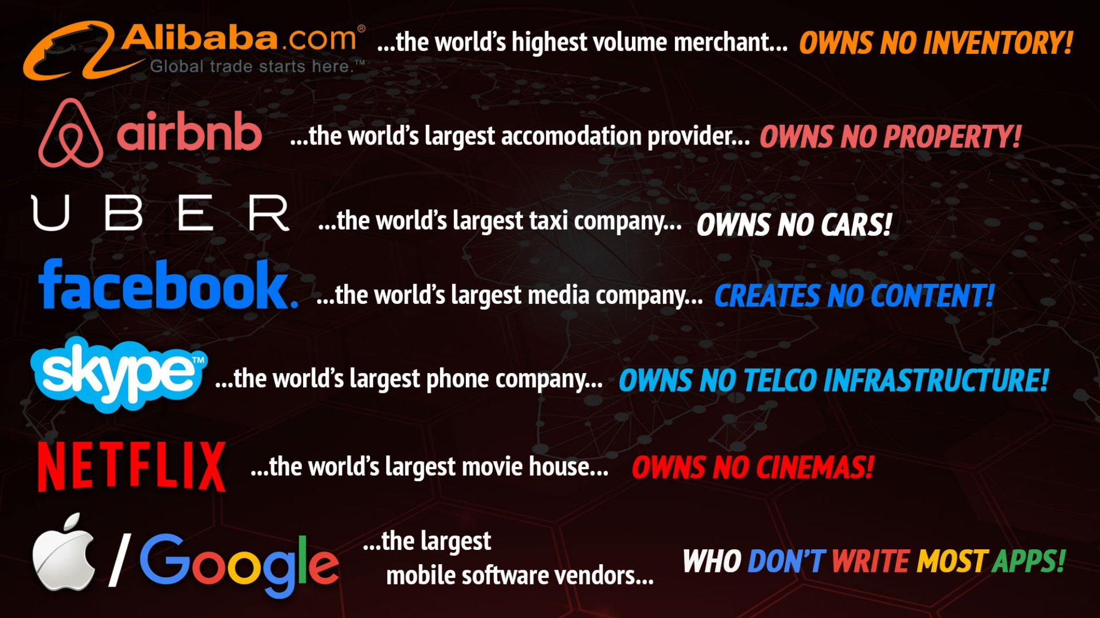

Slide 3
What are the key functions of data scientist?

Slide 4
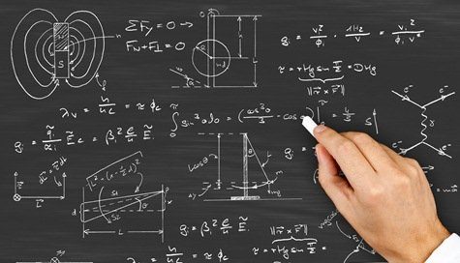


What do people think Data Scientist can do?
Lots of data
Complex mathematics in multidimensional spaces
Magical results

Slide 5
In reality…
Collect data
Clean and organize data
Create model
Use machines to flesh out the model from data
Deploy fleshed out model

Slide 6
Key functions of data scientist
Understanding the business problem
Data Mining and Analysis Design
Descriptive and Predictive Analytics
Devising Business Strategies from the insights

Slide 7
What type of work does a data scientist do?

Slide 8
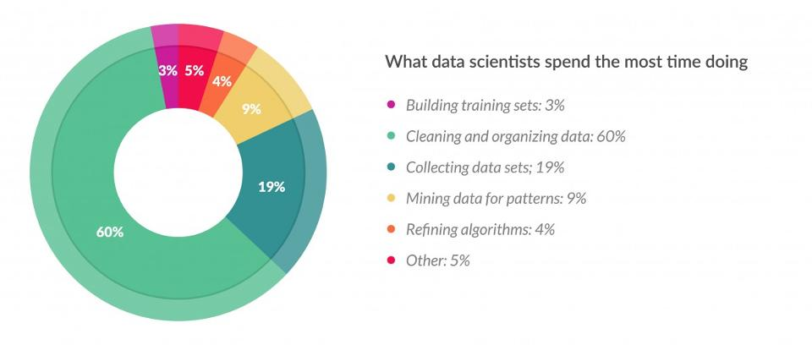
http://www.forbes.com/sites/gilpress/2016/03/23/data-preparation-most-time-consuming-least-enjoyable-data-science-task-survey-says/#f37c7f758459

Slide 9
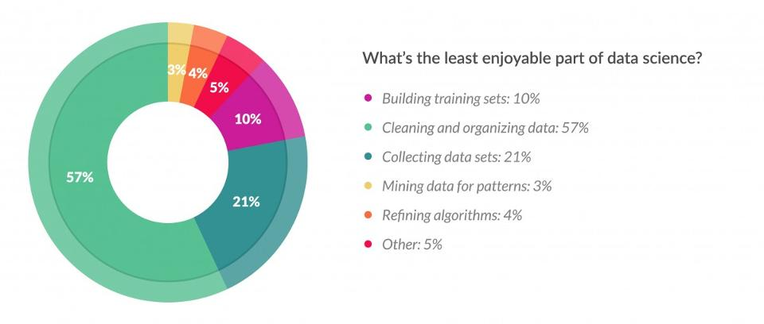
http://www.forbes.com/sites/gilpress/2016/03/23/data-preparation-most-time-consuming-least-enjoyable-data-science-task-survey-says/#f37c7f758459

Slide 10
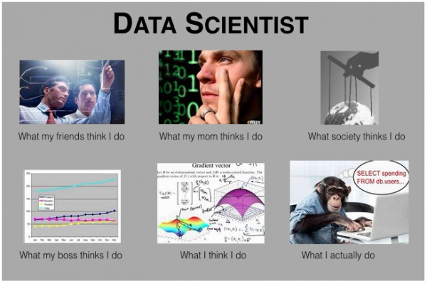

Slide 11
General aptitude to be Data Scientist

Slide 12

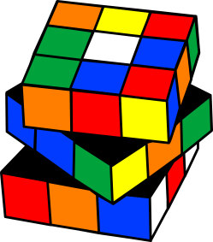

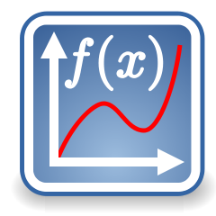


Love to solve puzzles
Common sense
Curious mind
Clear and simplify thought
Maths & Stats
Good listening, writing and communication skills (visualizations)
Business sense
Data Scientist

Slide 13




I have 4 red, 18 black and 8 brown socks in my sock drawer. If it is completely dark and I cannot see the colour of the socks that I am picking, how many socks do I need to take from the drawer to be sure that I have at least one pair of socks that are the same colour?
4

Slide 14
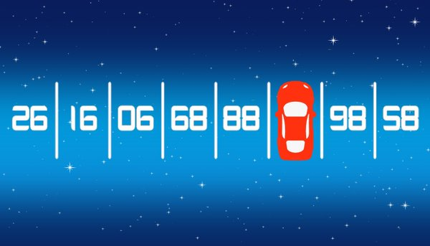
What is the hidden number under the car?
87

Slide 15
Data Analytics

Slide 16
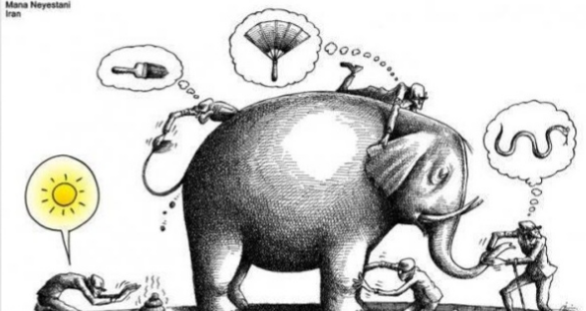

Slide 17
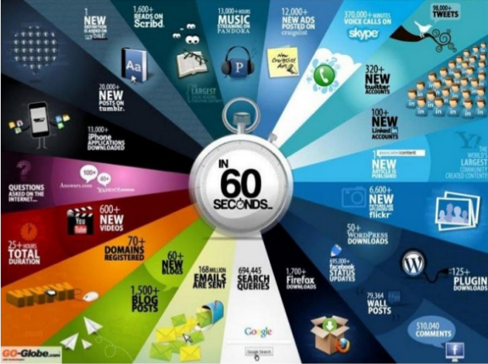

Slide 18
Analytics vs Analysis
Analysis refers to the process of separating a whole problem into its parts so that the parts can be critically examined at the granular level.
Analytics is a variety of methods, technologies and associated tools for creating new knowledge/insight to solve complex problems and make better and faster decisions
Delen(2015)

Slide 19
What Can Be Learned From Data?
Data analytics is an emerging technique that dives into a data set without prior set of hypotheses
The data derive meaningful trends or intriguing findings that were not previously seen or empirically validated (Leventhal, 2010).
Data analytics enables quick decisions or help change policies due to trends observed

Slide 20
Data Analytics
Accumulation of raw data captured from various sources (i.e. discussion boards, emails, exam logs, chat logs in e-learning systems) can be used to identify fruitful patterns and relationships (Bose, 2009)
Exploratory visualization – uses exploratory data analytics by capturing relationships that are perhaps unknown or at least less formally formulated
Confirmatory visualization - theory-driven

Slide 21
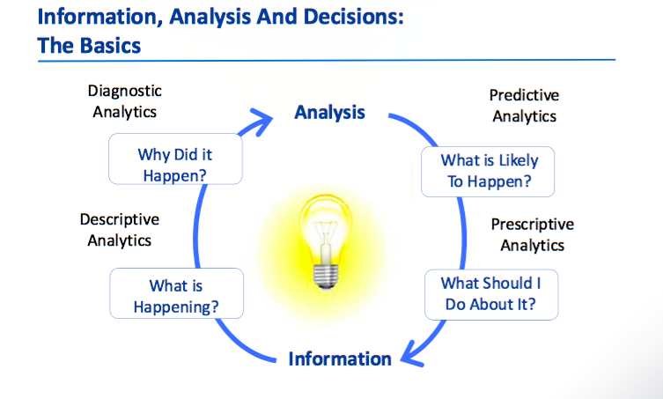
Types of Data Analytics

Slide 22
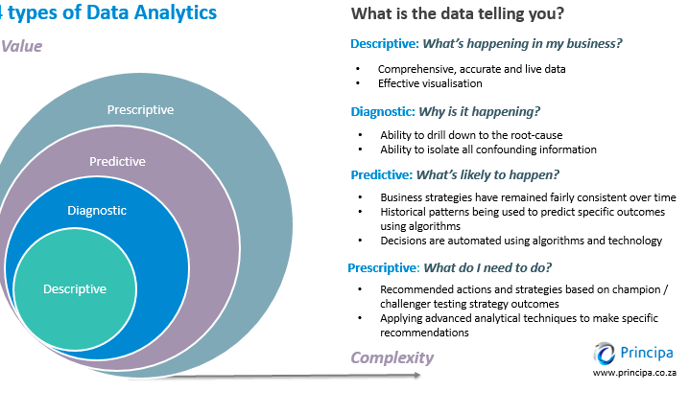

Slide 23
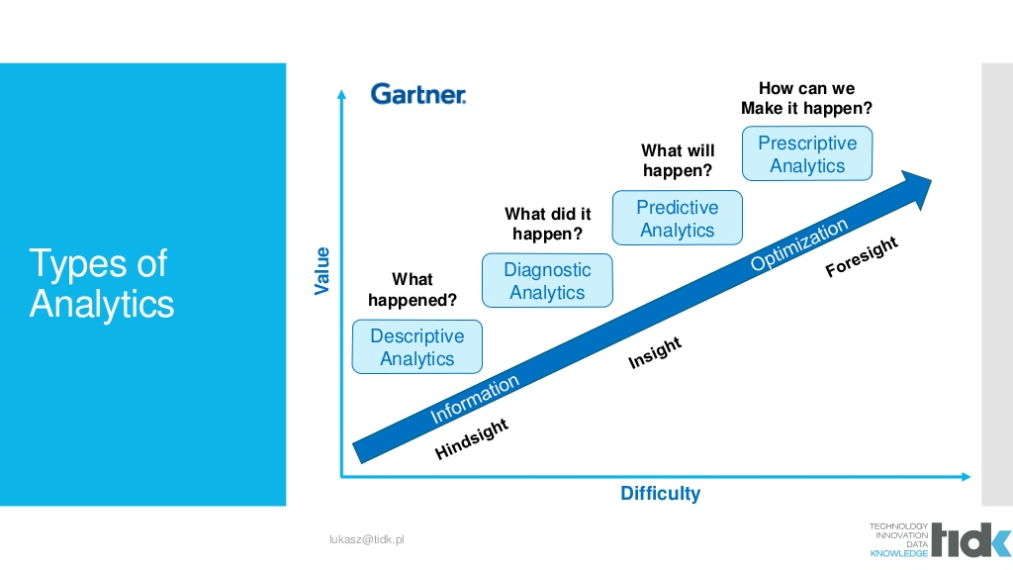
Data Analytics

Slide 24
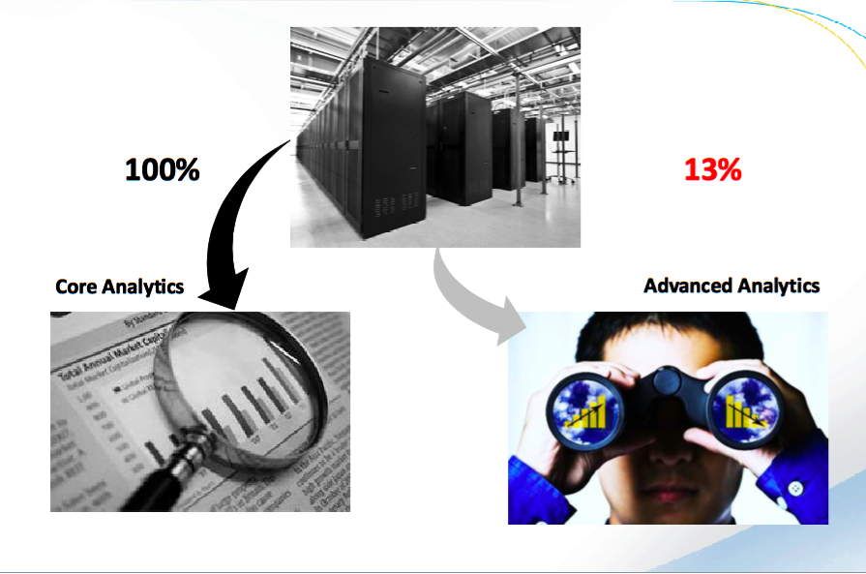
It is not about more data, it is about deeper look

Slide 25
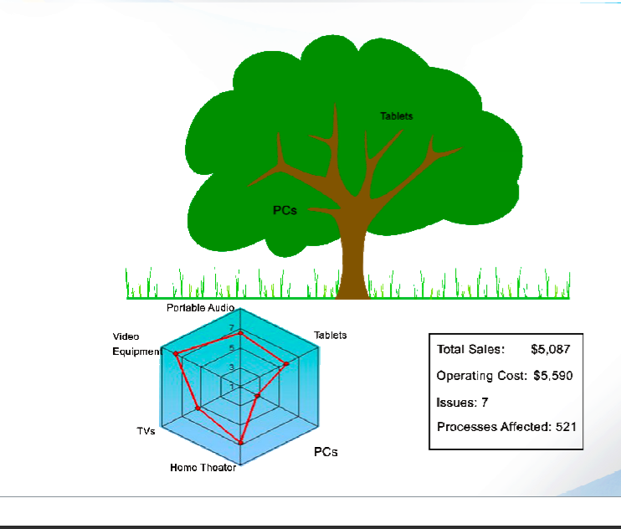
Descriptive What Happened?

Slide 26
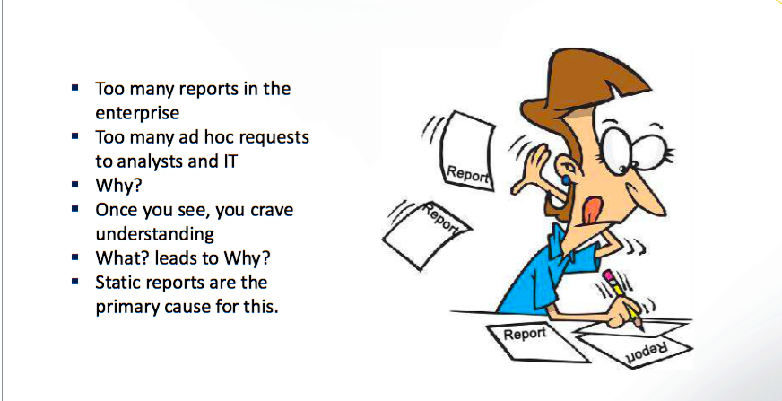
Descriptive What Happened?

Slide 27
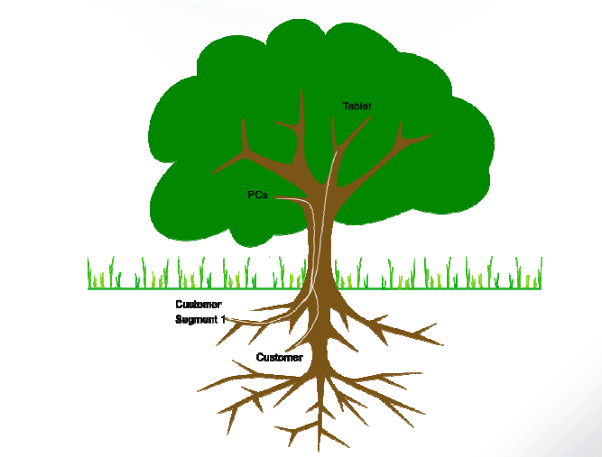
Diagnostic Why is it Happening?

Slide 28
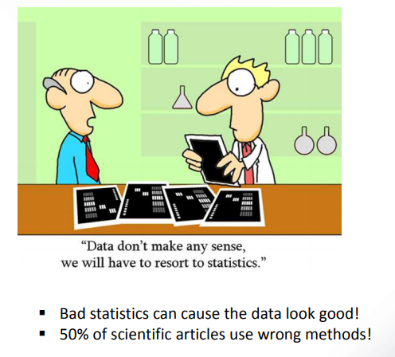
Predictive What is likely to happen?

Slide 29
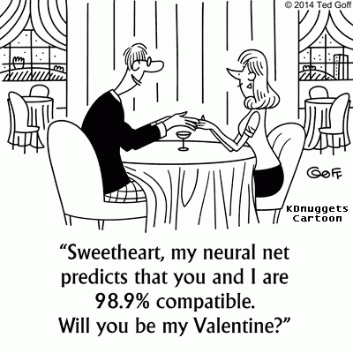
Predictive What is likely to happen?

Slide 30
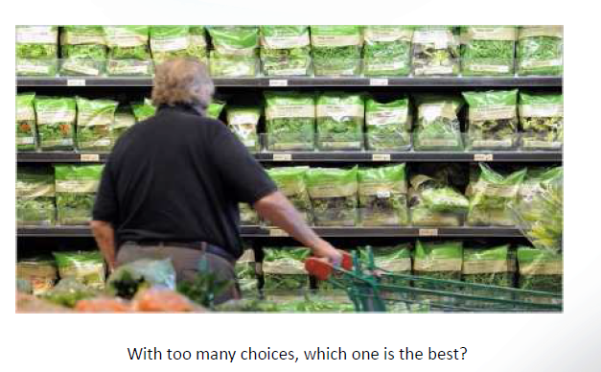
Prescriptive What do I need to do?

Slide 31
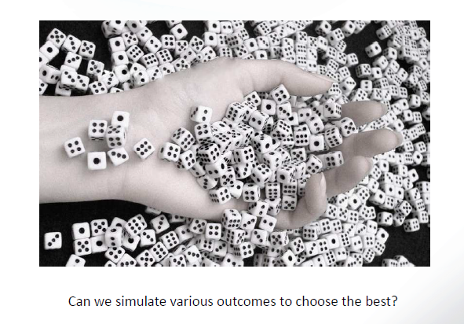
Prescriptive

Slide 32
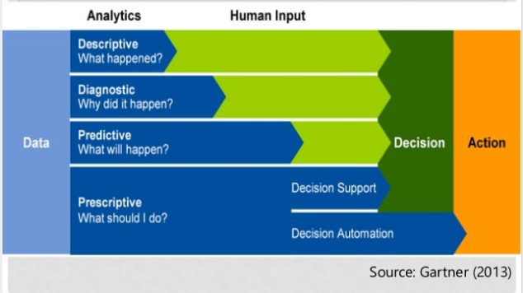
Types of Data Analytics

Slide 33
Data vs Information
Data:: numerical or textual facts and figures that are collected through some type of measurement process
Information: result of analyzing data; that is, extracting meaning from data to support evaluation and decision making

Slide 34
Data for Data Analytics
Data set: a collection of data.
Examples: Marketing survey responses, a table of historical stock prices, and a collection of measurements of dimensions of a manufactured item
Database: a collection of related files containing records on people, places or things.
A database file is usually organized in a two-dimensional table, where the columns corresponds to the each individual element of data (called fields, or attributes), and the rows represent records of related data elements.
Data warehouse: a collection of databases used for reporting and data analysis.
Data mart: A departmental data warehouse that stores only relevant data.S

Slide 35
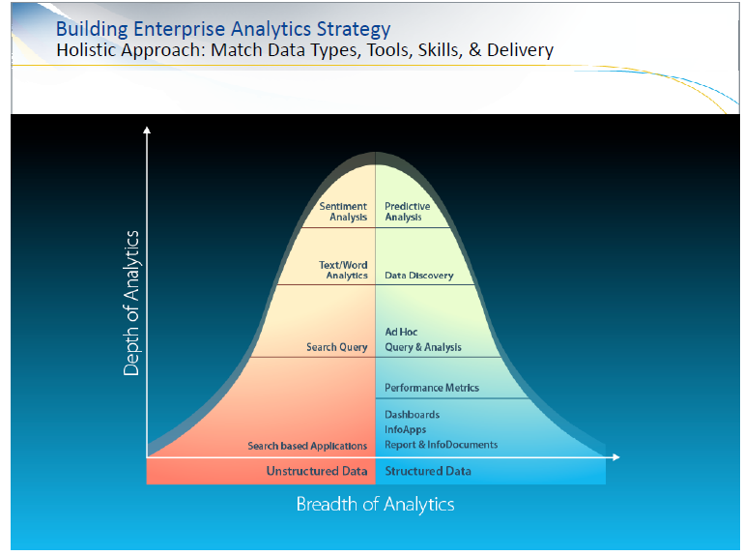

Slide 36
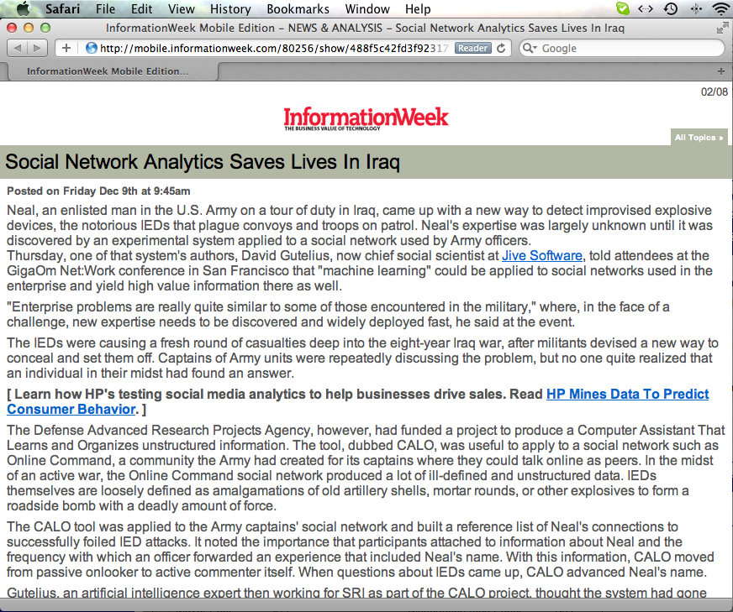
The Power of Data Analytics
Source: http://mobile.informationweek.com/80256/show/488f5c42fd3f92317e5ac29faeee033e/

Slide 37
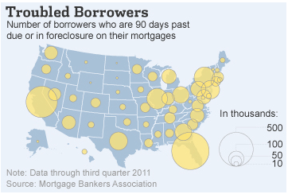
Data Analytics is Here to Stay!
Source: The Wall Street Journal

Slide 38
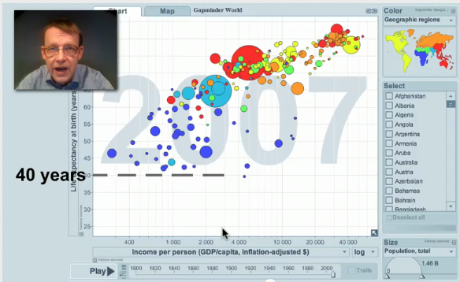
Data Analytics is Here to Stay!
Source: GapMinder.org

Slide 39

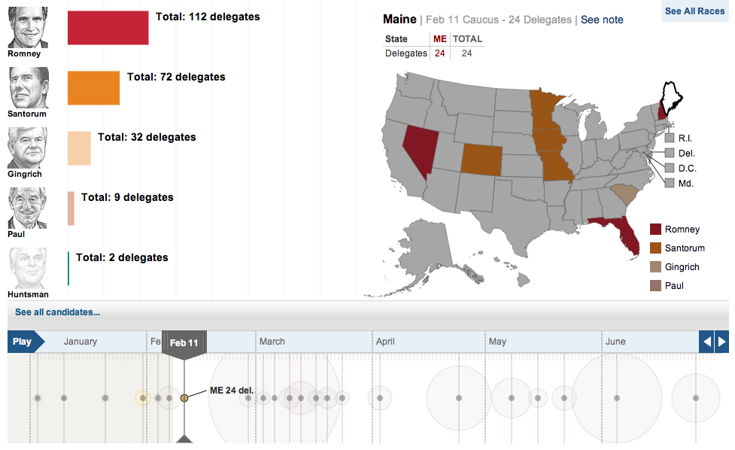
Source: The Wall Street Journal

